Slide 1
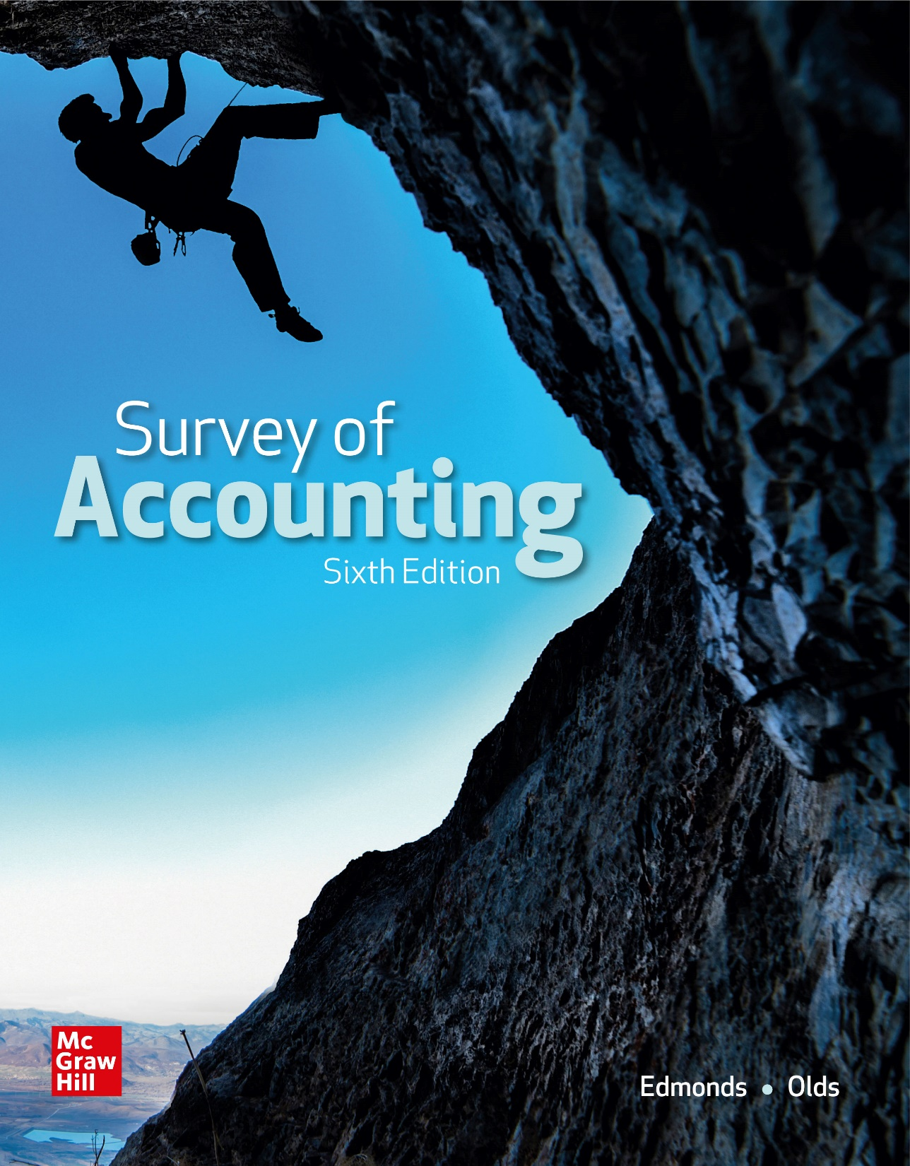
Chapter 7
Accounting for Liabilities

Slide 2
LO 7-1:
Show how notes payable and related interest expense affect financial statements.

Slide 3
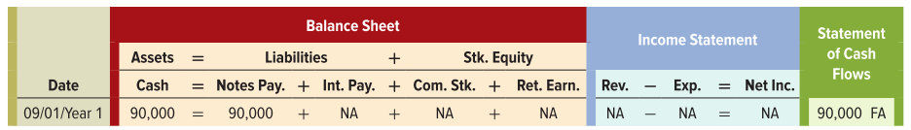
Accounting for Notes Payable
On September 1, Year 1 Herrera Supply Company (HSC) borrowed $90,000 from the National Bank. HSC issued a note payable that had a one-year term and an annual interest rate of 9%.

Slide 4
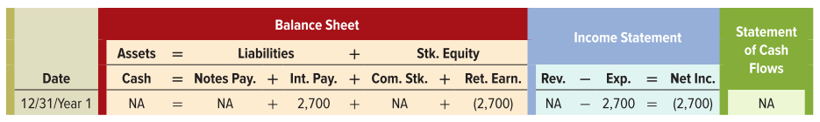
Accrual of Interest Expense
On December 31, Year 1, HSC would recognize four months (September 1 through December 31) of accrued interest expense. The accrued interest is $2,700 [$90,000 x 0.09 x (4 ÷ 12)].

Slide 5
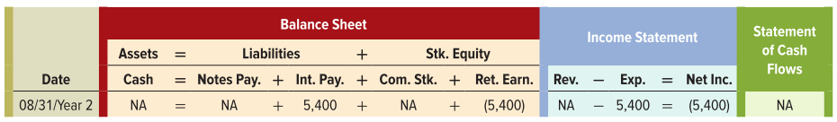
Payment of Principal and Interest at Maturity Date
HSC would record three events on August 31, Year 2 (the maturity date). The first event recognizes $5,400 of interest expense that accrued in Year 2 from January 1 through August 31 [$90,000 x 0.09 x (8 ÷ 12)].

Slide 6
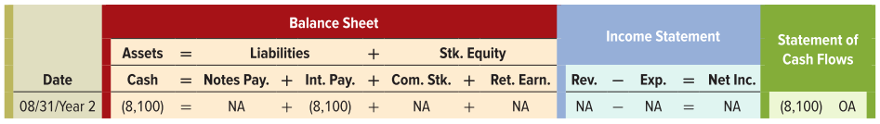
Payment of Principal and Interest at Maturity Date
The second event recognized HSC’s cash payment for interest on August 31, Year 2. This event is an asset use transaction that reduces both the Cash and Interest Payable accounts for the total amount of interest due, $8,100 [$90,000 x 0.09 x (12 ÷ 12)].

Slide 7
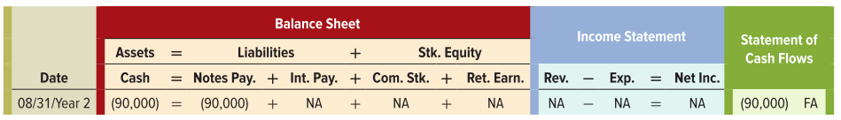
Payment of Principal and Interest at Maturity Date
The third event on August 31, Year 2, reflects repaying the principal.

Slide 8
LO 7-2:
Show how sales tax liabilities affect financial statements.

Slide 9
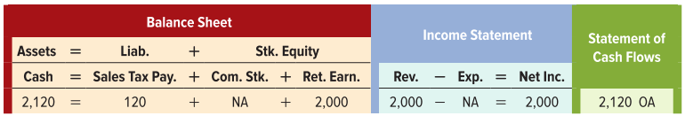
Accounting for Sales Tax
Most states require retail companies to collect sales tax on items sold to their customers. The retailer then remits the tax to the state at regular intervals. Sales tax is a liability to the retailer until paid to the state.
Herrera Supply Company (HSC) sells merchandise to a customer for $2,000 cash plus tax in a state where the sales tax rate is 6 percent.

Slide 10
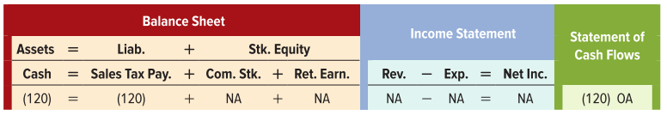
Accounting for Sales Tax
Remitting the tax (paying cash to the tax authority) is an asset use transaction.

Slide 11
LO 7-3:
Define contingent liabilities and show how they are reported in financial statements.

Slide 12
Contingent Liabilities
A contingent liability is a potential obligation arising from a past event. The amount of existence of the obligation depends on some future event.
If the likelihood is probable and the amount can be reasonably estimated, a liability is recognized in the financial statements.
If the likelihood is reasonable possible but not likely or if it is probably but cannot be reasonably estimated, the potential liability is disclosed in the notes to the financial statements.
If the likelihood is remote, there is no liability and no disclosure.

Slide 13
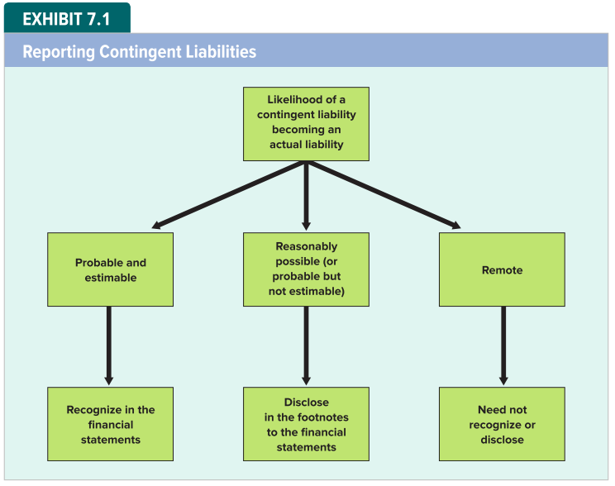
Reporting Contingent Liabilities

Slide 14
LO 7-4:
Show how warranty obligations affect financial statements.

Slide 15
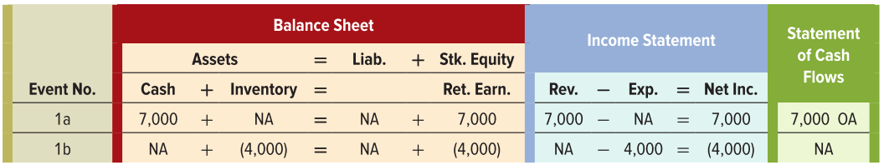
Warranty Obligations: Sale of Merchandise
To attract customers, many companies guarantee their products or services. Within the warranty period, the seller promises to replace or repair defective products without charge.
Event 1 Sale of Merchandise
HSC sold for $7,000 of merchandise for cash that had cost $4,000

Slide 16
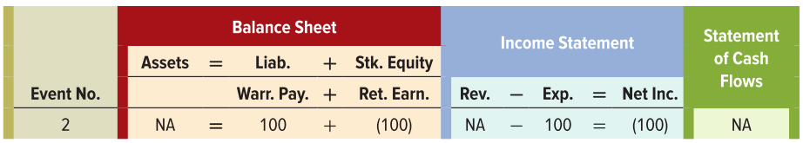
Warranty Obligations: Recognition of Warranty Expense and Settlement of Warranty Obligation
Event 2 Recognition of Warranty Expense
HSC guaranteed the merchandise sold in Event 1 to be free from defects for one year following the date of sale. Assume the warranty obligation is estimated to be $100.

Slide 17
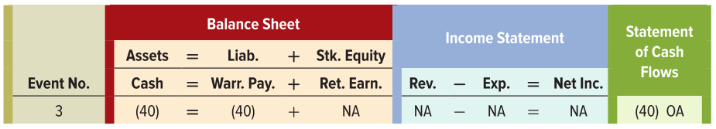
Warranty Obligations: Recognition of Warranty Expense and Settlement of Warranty Obligation
Event 3 Settlement of Warranty Obligation
HSC paid $40 cash to repair defective merchandise returned by a customer.

Slide 18
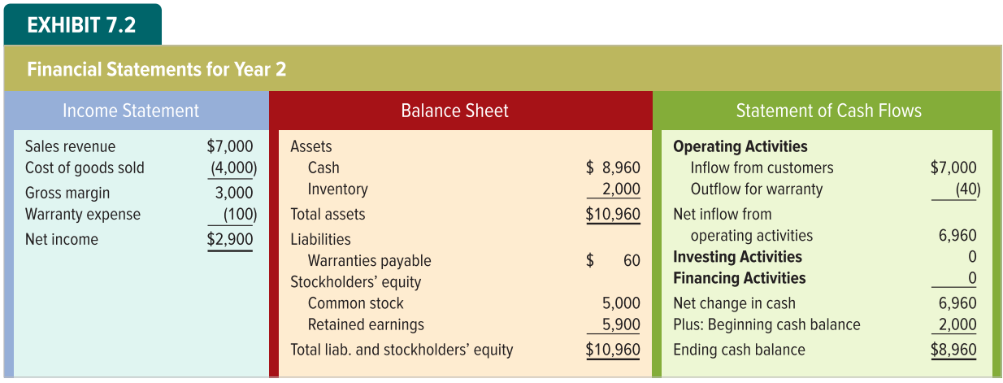
Financial Statement Presentation of Warranties

Slide 19
Accounting for Long-Term Debt
Most businesses finance their investing activities with long-term debt. Current liabilities mature within one year or a company’s operating cycle, whichever is longer. Other liabilities are long-term liabilities.
Interest charges may be based on a fixed or a variable interest rate.
Principal repayment is generally required either in one lump sum at the maturity date or in installments.

Slide 20
LO 7-5:
Show how installment notes affect financial statements.

Slide 21
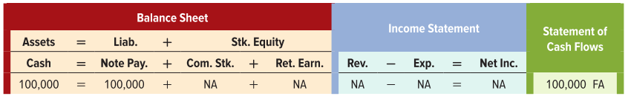
Installment Notes Payable
Loans that require payments of principal and interest at regular intervals (amortizing loans) are typically represented by installment notes, which typically have terms of two to five years.
Assume Blair Company borrowed $100,000 cash from the National Bank on January 1, Year 1. Blair issued the bank a five-year installment note with a 9 percent fixed interest rate.

Slide 22
Amortization of Principal and Interest
The loan agreement required Blair to pay five equal installments of $25,709 on December 31 of each year. The amounts in Exhibit 7.3 are computed as follows:
The Interest Expense (Column D) is computed by multiplying the Principal Balance on Jan. 1 (Column B) by the interest rate.
The Principal Repayment (Column E) is computed by subtracting the Interest Expense (Column D) from the Cash Payment on Dec. 31 (Column C).
The Principal Balance on Dec. 31 (Column F) is computed by subtracting the Principal Repayment (Column E) from the Principal Balance on Jan. 1 (Column B).

Slide 23
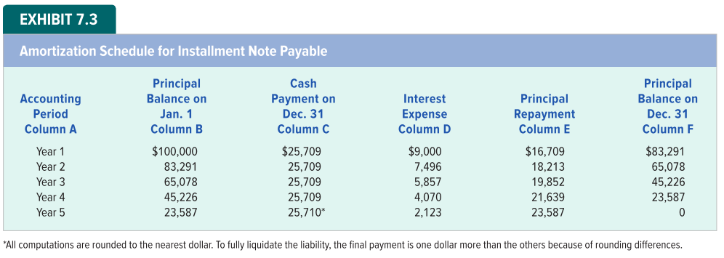
Amortization for Installment Note Payable

Slide 24
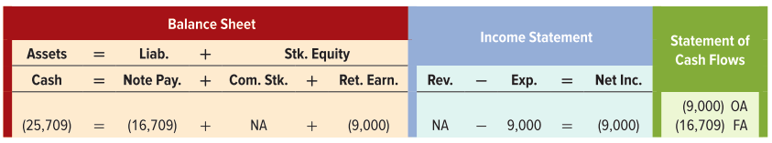
Recording an Installment Note Payable
Although the amounts for interest expense and principal repayment differ each year, the effects of the annual payment on the financial statements are the same. On the balance sheet, assets (cash) decrease by the total amount of the payment; liabilities (note payable) decrease by the amount of the principal repayment; and stockholders’ equity (retained earnings) decreases by the amount of interest expense.

Slide 25
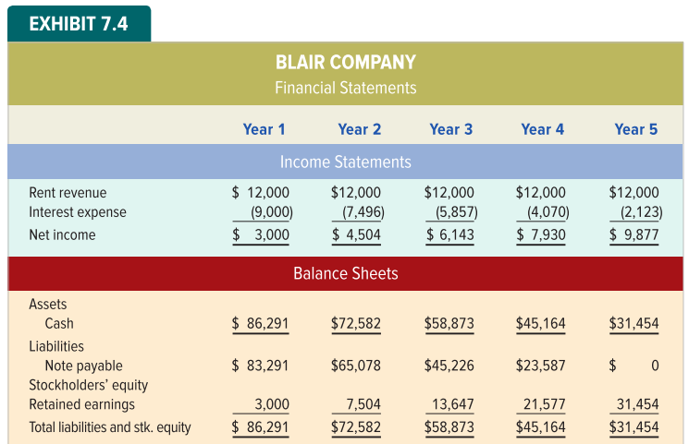
Financial Statement Presentation of Installment Note Payable

Slide 26
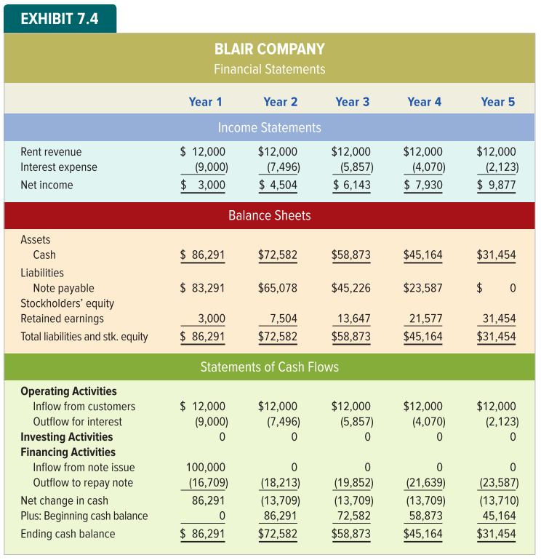
Financial Statement Presentation of Installment Note Payable

Slide 27
LO 7-6:
Show how a line of credit affects financial statements.

Slide 28
Line of Credit
A line of credit enables a company to borrow or repay funds as needed. Credit agreements usually specify a limit on the amount that can be borrowed.
Interest rates on lines of credit normally vary with fluctuations in some designated interest rate. Lines of credit typically have one-year terms.

Slide 29

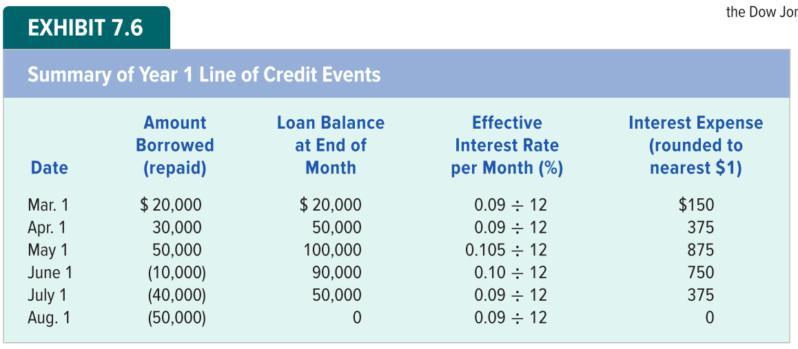
Line of Credit Example
Lagoon Company borrows money using a line of credit to finance building up its inventory. Lagoon repays the loan over the summer using cash generated from sales. Borrowing or repaying events occur on the first of the month.

Slide 30
LO 7-7:
Show how bonds issued at face value affect financial statements.

Slide 31
Bond Liabilities
Many companies borrow money directly from the public by selling bond certificates, called issuing bonds. They describe a company’s obligation to pay interest and to repay the principal.
From the issuer’s point of view, a bond represents an obligation to pay a sum of money, the face value, to the bondholder on the bond’s maturity date.

Slide 32
Advantages of Issuing Bonds
Bond financing offers companies the following advantages:
Bonds usually have longer terms than notes issued to banks. Longer terms to maturity allow companies to implement long-term strategic plans without having to worry about frequent refinancing arrangements.
Bond interest rates may be lower than bank interest rates. By issuing bonds directly to the public, companies can pay lower interest costs by eliminating the intermediary (banks).

Slide 33
Bonds Issued at Face Value
Marsha Mason needs cash to seize a business opportunity. Mason offers to sell her friends bonds with a 9 percent stated interest rate. The terms specified making interest payments in cash on December 31 of each year, a five-year term to maturity, and pledging land as collateral for the bonds. Mason issued the bonds in exchange for cash on January 1, Year 1.

Slide 34
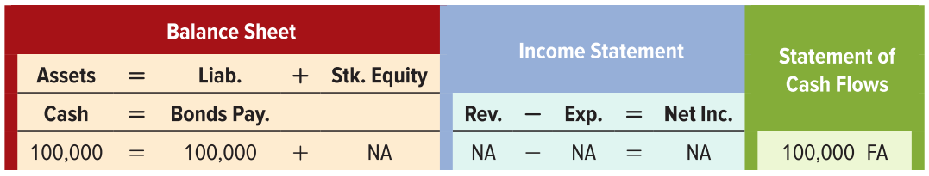
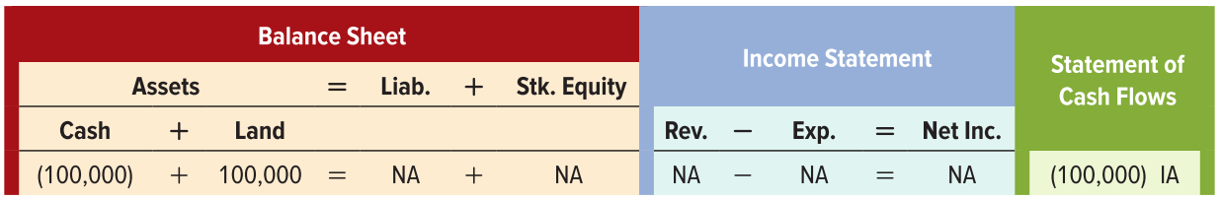
Bonds Issued at Face Value: Events 1 and 2
Event 1 Issue bonds for cash.
Event 2 Investment in Land

Slide 35
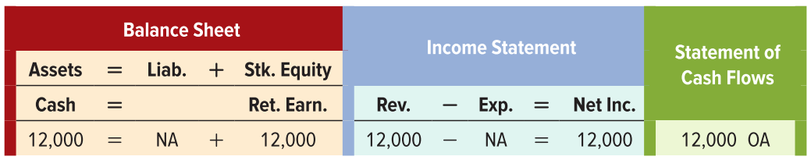
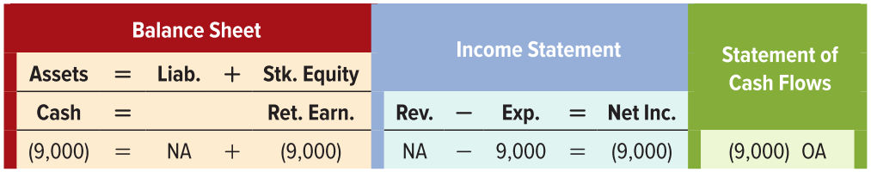
Bonds Issued at Face Value: Events 3 and 4
Event 3 Revenue Recognition
Event 4 Expense Recognition
$100,000 x 0.09 = $9,000

Slide 36
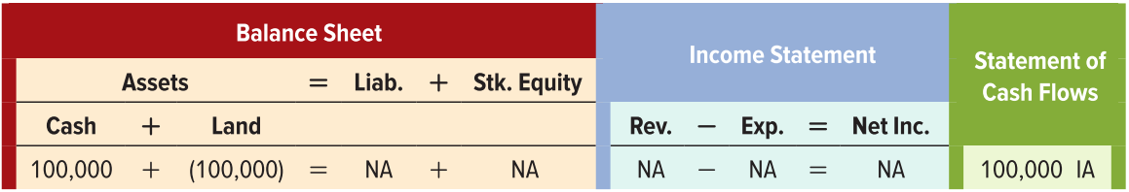
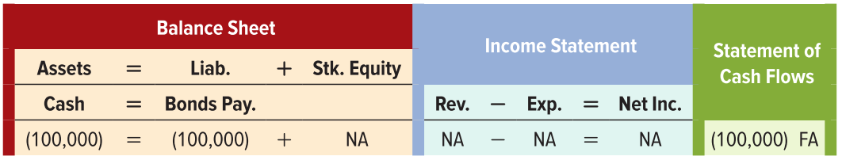
Bonds Issued at Face Value: Events 5 and 6
Event 5 Sale of Investment in Land
Event 6 Payoff of Bond Liability

Slide 37
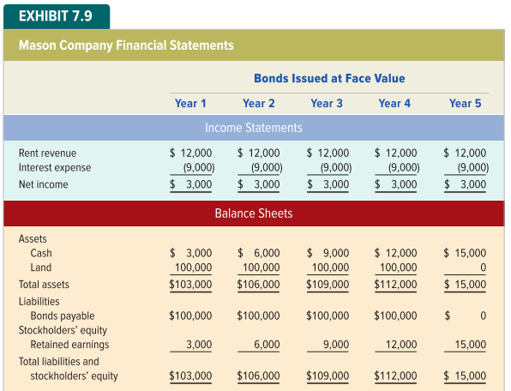
Financial Statement Presentation of Bonds Issued at Face Value

Slide 38
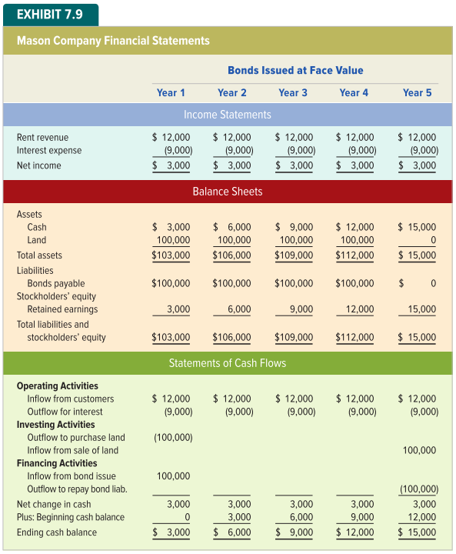
Financial Statement Presentation of Bonds Issued at Face Value

Slide 39
LO 7-10:
Distinguish between current and noncurrent assets and liabilities on a classified balance sheet.

Slide 40
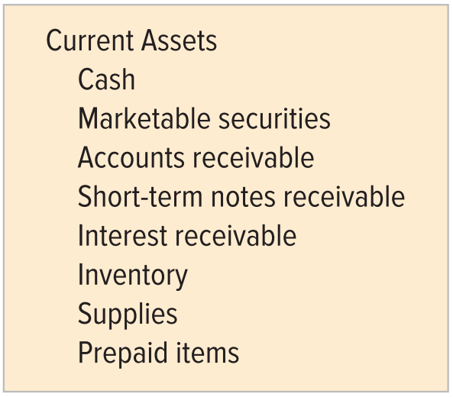
Current versus Noncurrent Assets
Current assets are expected to be converted to cash or consumed within one year or an operating cycle, whichever is longer. Current assets include:

Slide 41
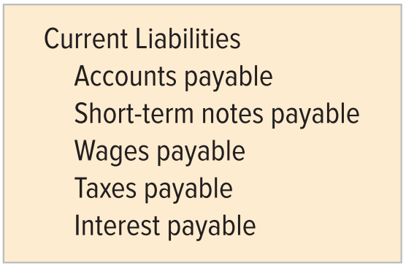
Current versus Noncurrent Liabilities
Current liabilities are due within one year or an operating cycle, whichever is longer. Current liabilities, also called short-term liabilities, include:

Slide 42
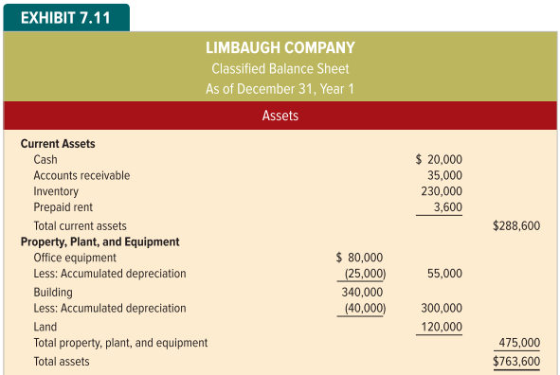
Financial Statement Presentation of Current and Noncurrent Assets

Slide 43
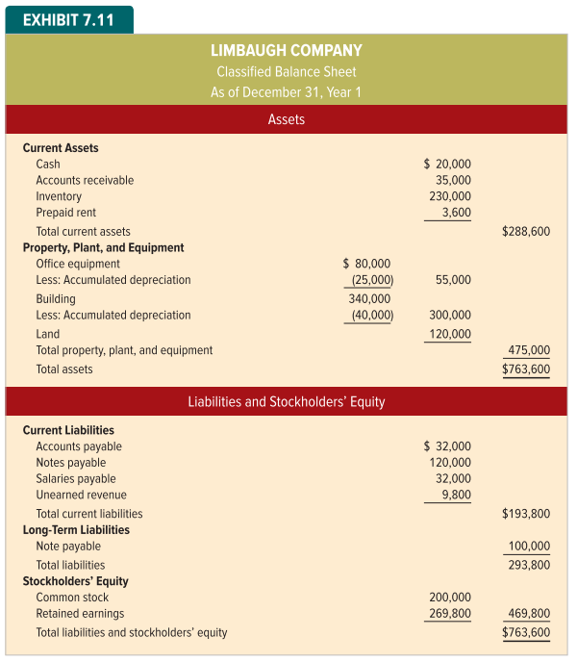
Financial Statement Presentation of Current and Noncurrent Liabilities

Slide 44
End of Chapter 7

